Slide 1

Movie Analysis

Slide 2
Business Problem
Explore what types of films are currently doing the best at the box office. You must then translate those findings into actionable insights that the head of your company's new movie studio can use to help decide what type of films to create.

Slide 3
Data
The data used was obtained from im.db. This contained basic movie information (e.g. movie title, directors, genre, movie ratings). Box office gross, a CSV file containing movie financials (e.g. gross revenue foreign and domestic,)

Slide 4
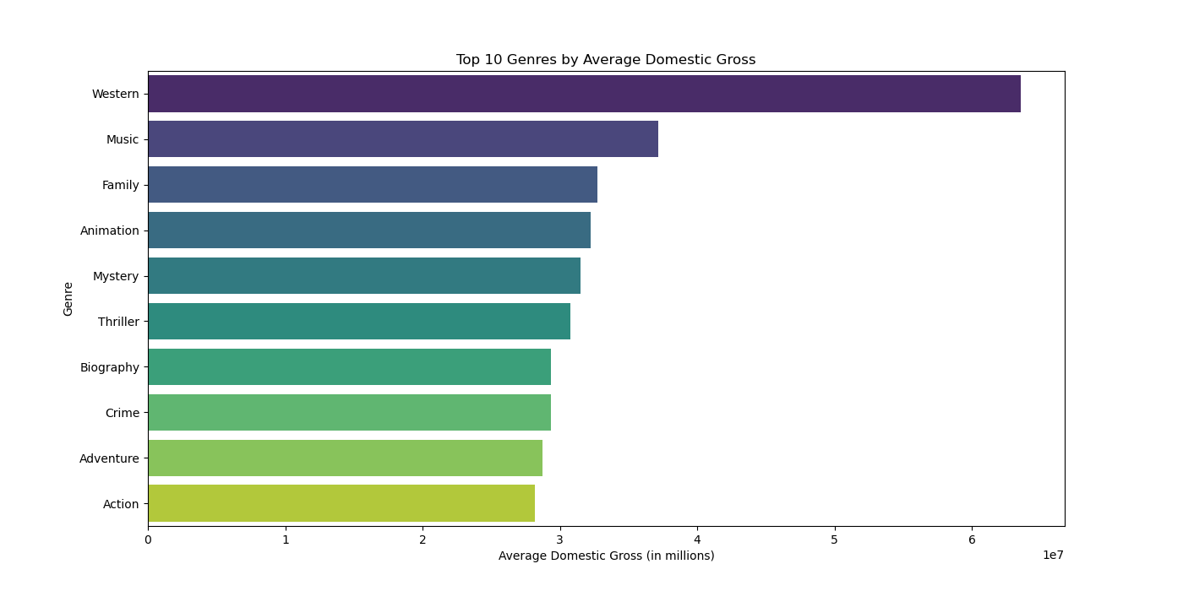
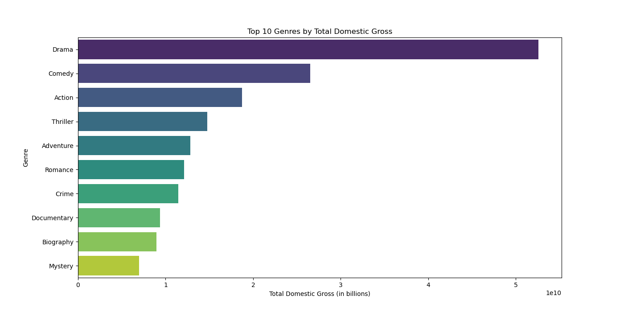
Top 10 Genres by Avg and Total Domestic Gross
Notes:
the two visualizations on the slide illustrate the top 10 genres by average and total domestic gross.
Top 10 Genres by Average Domestic Gross (Left Chart)
Key Points:
The bar chart shows the average domestic gross for each genre.
Westerns lead with the highest average domestic gross, indicating that individual Western films perform exceptionally well on average.
Other high-performing genres include Music, Family, Animation, and Mystery.
Top 10 Genres by Total Domestic Gross (Right Chart)
Key Points:
The bar chart shows the total domestic gross for each genre.
Drama dominates in total domestic gross, showing that this genre collectively brings in the highest revenue.
Comedy and Action also show significant total gross, followed by Thriller, Adventure, and Romance.

Slide 5
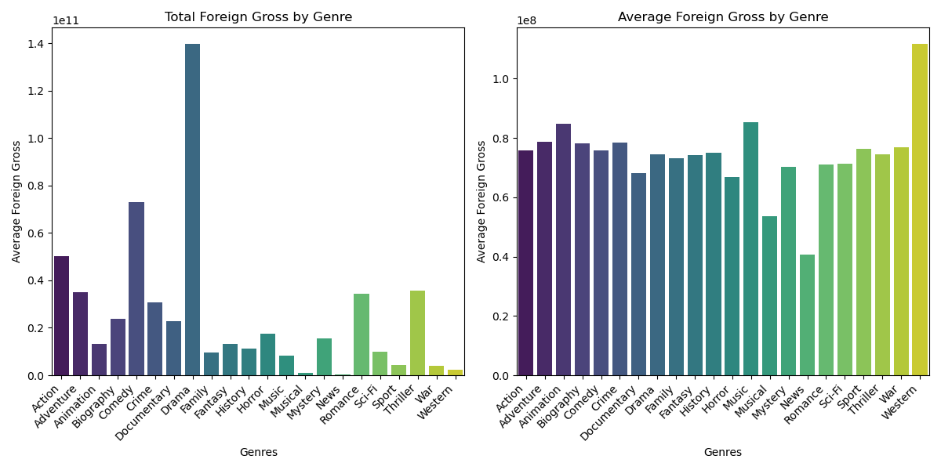
Foreign Box Office Success by Genre
Notes:
the two visualizations on the slide illustrate the total and average foreign gross by genre.
Total Foreign Gross by Genre (Left Chart)
Key Points:
The bar chart shows the total foreign gross for each genre.
Notable outlier: The Family genre has an exceptionally high total foreign gross, indicating a significant contribution to overall earnings.
Other high-performing genres include Action, Drama, and Comedy, which also show substantial total gross earnings.
Average Foreign Gross by Genre (Right Chart)
Key Points:
The bar chart shows the average foreign gross for each genre.
The Western genre, although not the highest in total gross, shows the highest average foreign gross, suggesting that individual Western films tend to perform very well internationally.
Other genres with high average foreign gross include Musical, Family, and Adventure.

Slide 6
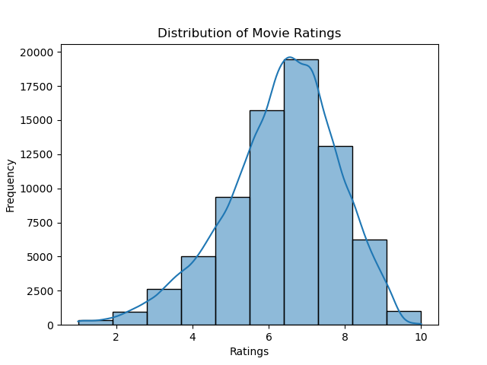
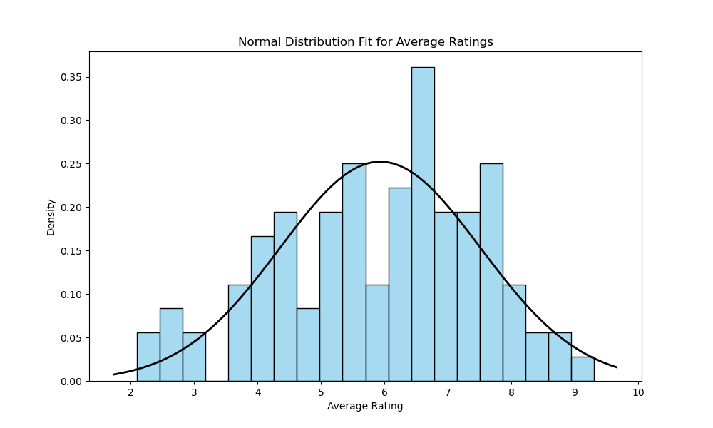
Distribution of Movie Ratings
Notes:
the two visualizations on the slide illustrate the overall distribution of movie ratings and how they fit into a normal distribution.
Distribution of Movie Ratings (Left Chart)
Key Points:
The histogram shows the frequency of movies at each rating level.
Most movies are rated between 5 and 7, with a peak around rating 6.
The distribution is slightly right-skewed, indicating a larger number of high-rating movies compared to low-rating movies.
Normal Distribution Fit for Average Ratings (Right Chart)
Key Points:
The histogram shows the distribution of average ratings overlaid with a normal distribution curve.
The normal distribution curve helps to visualize the central tendency and dispersion of the ratings.
The majority of movies cluster around the mean rating of approximately 6, with fewer movies receiving very high or very low ratings.
Central Tendency:The mean and median ratings are around 6, suggesting that most movies receive moderate to good reviews.
High ratings (8 and above) are less common, indicating that exceptional movies are rare.
Dispersion:The spread of ratings shows a standard deviation indicating variability in movie quality as perceived by audiences.
The skewness suggests that while most movies are average, there is a slight tendency for movies to receive higher ratings rather than very low ones.

Slide 7
Recommendations
We can derive several actionable insights to address the business problem based on the analyses performed.
High Total Gross: Drama and Western consistently show the highest total gross.
Average Ratings and Votes: Prioritize genres like Comedy and Drama. Both have high engagement and favorable audience ratings.
Hypothesis Testing Results: Invest in Drama and Comedy Genres. They perform well in terms of audience ratings and engagement.

Slide 8
Conclusion
Three Genres to Focus on to Maximize Revenue:
Drama
Comedy
Western

